Slide 1
PRESENTATION
On
“Movie Mate: Your Film Companion”
Presented
by
Kashish Mahana(2210990497)
Khushi Bansal(2210990511
Under the supervision
of
Dr. Jatin Arora
Mr.Shubham Singhal

Slide 2
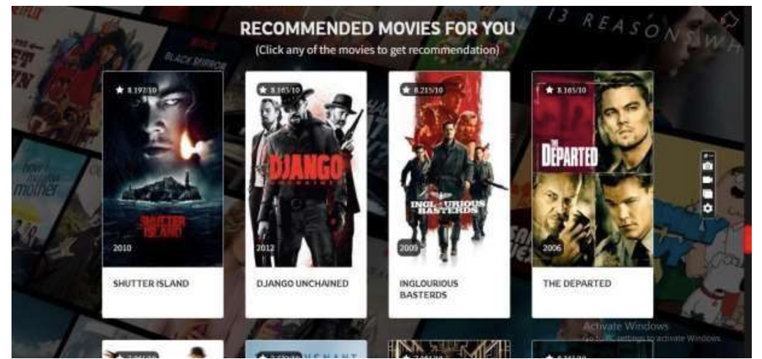
Project Title
“MOVIE MATE: Your Film Companion”

Slide 3
Introduction
Movie recommendation system that provides personalized movie recommendations based on a user's movie preferences.
In today's digital world, there are countless options for movie streaming services, but finding the right movie to watch can be overwhelming. Movie Recommender is designed to solve this problem by providing movie recommendations, making it easier for users to find movies they will enjoy.
3

Slide 4
Problem Statement
Traditional Movie Recommender: They are often not personalized enough to meet the unique preferences and tastes of individual users. Many users find it difficult to discover new movies that they will enjoy watching, and this can result in reduced user engagement and satisfaction.
The Movie Recommender System aims to address this problem by providing personalized movie recommendations to users based on their viewing preferences. The system can accurately recommend movies that users are likely to enjoy watching, thereby increasing user engagement and satisfaction
4

Slide 5
Objective
The project aims to meet the following objectives:
1. To provide personalized movie recommendations to users based on their viewing preferences.
2. To improve user engagement and satisfaction by accurately recommending movies that users are likely to enjoy watching.
3. To provide an easy-to-use interface for users to interact with the system, making it accessible and user-friendly.
4. Provide sentiment analysis to the movie reviews to help users decide properly
5

Slide 6
DataSet:-
MovieLens review dataset (ml-latest-small)
Ratings: 100k
Movies: 9k
Users: 600
Integrated the dataset with IMDB and TMDB data set publically available.
Split the dataset into 80% training and 20% testing based on the User ID.

Slide 7
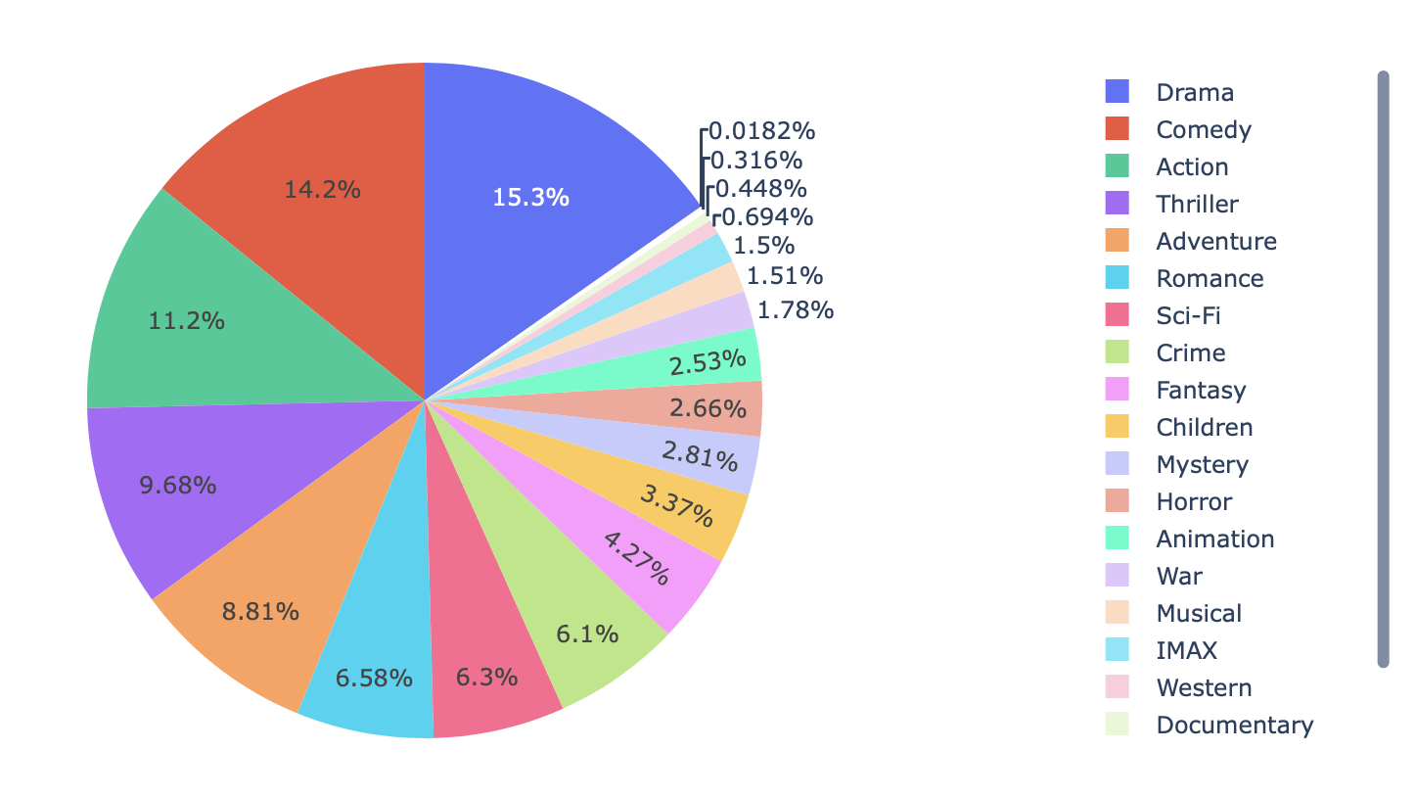
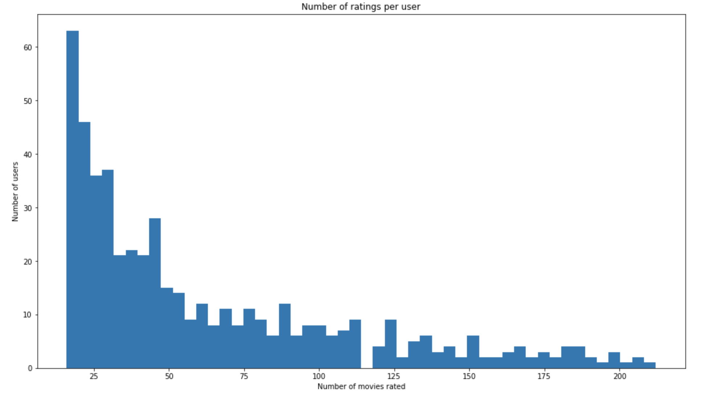
Data Analysis:-
Genre Distribution:
2. Number of ratings per user:

Slide 8
MODELS:-
Popularity based model
Content based model
Collaborative Filtering
Sentimental Analysis

Slide 9
Content-Based Filtering
Content-based filtering recommends items (like movies) based on their attributes or features. In the context of movies, these attributes could be genre, actors, directors, and plot keywords.
The system learns your preferences from the items you've liked in the past and suggests similar items.
Example:
Imagine you really enjoyed "The Dark Knight." A content-based filtering system might recommend other superhero movies like "Avengers" or "Spider-Man," because they share similar attributes such as action-packed scenes, superhero themes, and intense plotlines.

Slide 10
Collaborative Filtering
Collaborative filtering recommends items based on the preferences of other users who are similar to you. It doesn't rely on the attributes of the items themselves but rather on the behavior and preferences of users.
It finds patterns in users' behaviors, like ratings or movie-watching history, to make recommendations.
Let's say you and your friend have similar tastes in movies. If your friend enjoyed watching "Inception" and "Interstellar," a collaborative filtering system might suggest those movies to you because it identifies your similarity in tastes. It assumes that if your friend liked those movies, you might enjoy them too.

Slide 11
Content based vs Collaborative filtering
Content-based filtering looks at the characteristics of items to make recommendations, while collaborative filtering looks at the behavior and preferences of users to make suggestions.
Both methods have their strengths and weaknesses, but when combined, they can create more accurate and diverse recommendations for users.

Slide 12
Sentimental Analysis
Sentiment analysis involves analyzing text data to determine the sentiment or emotion expressed within it.
In the context of movie reviews or comments, sentiment analysis can help classify whether a review is positive, negative, or neutral based on the language used.
Let's say you write a review for the movie "The Shawshank Redemption" saying, "Absolutely loved it! The storyline was captivating, and the performances were brilliant." Sentiment analysis would classify this review as positive because it expresses admiration and satisfaction towards the movie.

Slide 13
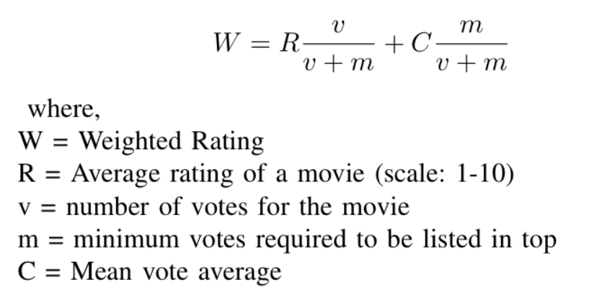
Popularity Model
Genre wise popular movies
Computed on:
Popularity metric from TMDB data
Weighted Rating from IMDB

Slide 14
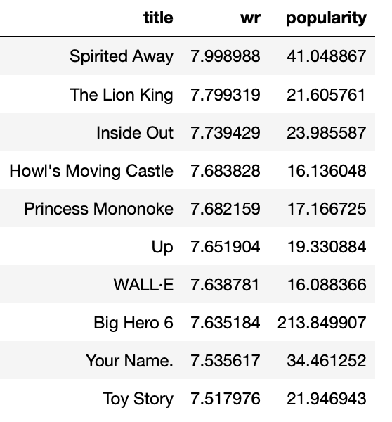
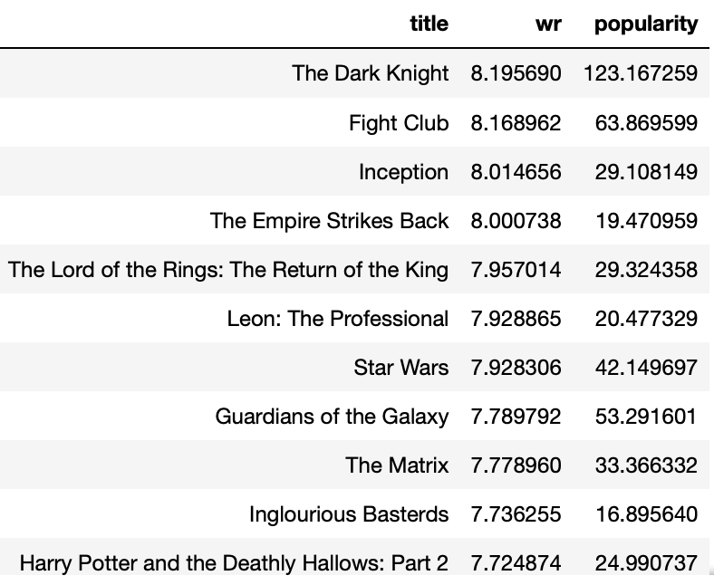
Popularity Model
Action Movies Animated Movies

Slide 15
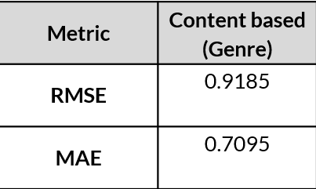
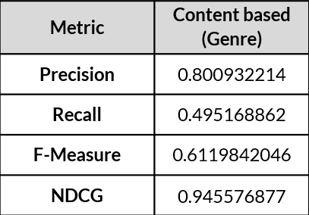
Evaluation metrics:-

Slide 16
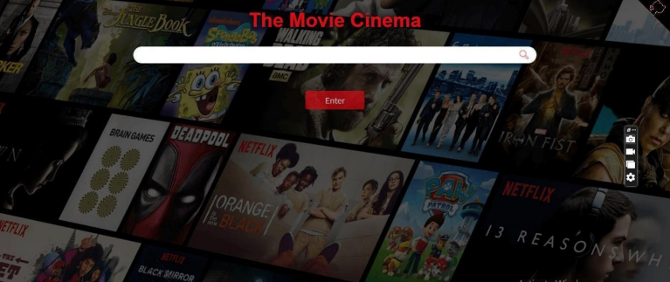
ScreenShots

Slide 17
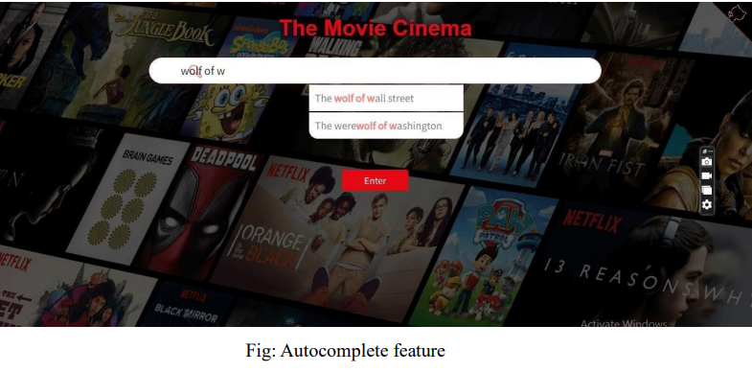
ScreenShots

Slide 18
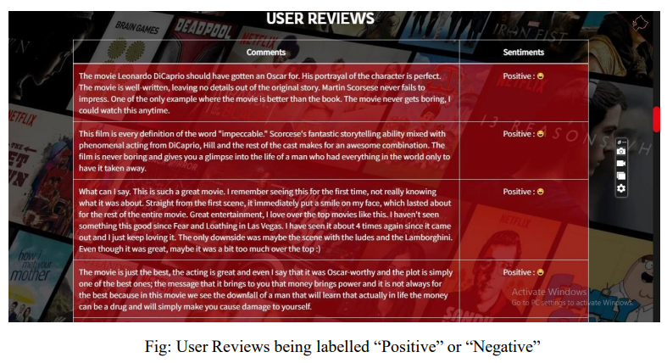

Slide 19
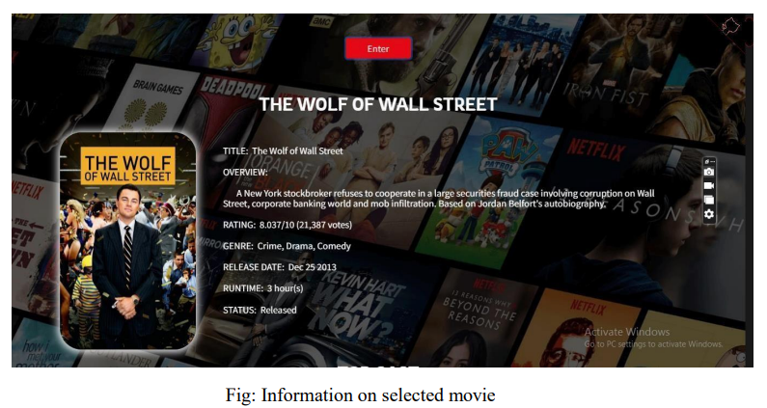

Slide 20
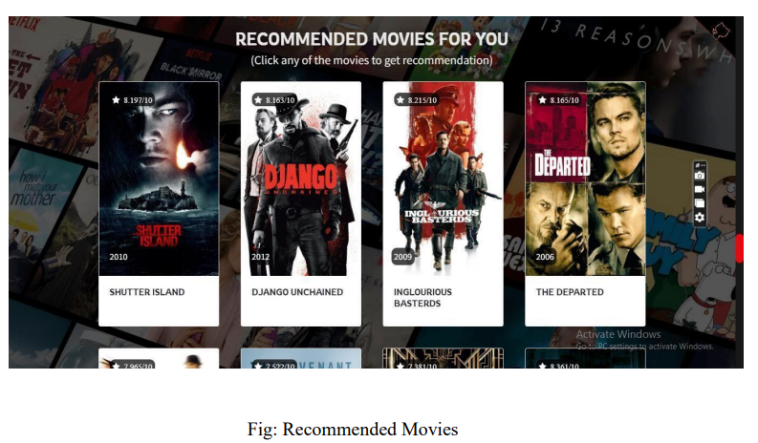

Slide 21


